Slide 1

RECAP – COURSE OUTCOME-1:
Understood the internals of UNIX kernel architectures and explore design of File Subsystem, buffer cache, and File System Calls.

Slide 2
kernel Architecture (UNIX)
User program
Library
User level
system call interface
kernel level
File Subsystem
Inter process
communication
Buffer Cache
Process Control
Subsystem
Scheduler
Memory Management
character block
Device driver
Hardware control
kernel level
hardware
Hardware level

Slide 3
File Sub System
A file system is consists of a sequence of logical blocks (512/1024 bytes)… A file system has the following structure:
Boot Block:
The beginning of the file system
Contains bootstrap code to load the os
Initialize the operating system
Typically occupies the first sector of the disk
Boot Block | Super Block | Inode List | Data Blocks
Inode List:
Inodes are used to access disk files.
Inodes maps the disk files
For each file there is an inode entry in the inode list block
Inode list also keeps track of directory structure
Super Block
Describes the state of a file system
Describes the size of the file system
How many files it can store
Where to find free space on the file system
Other information
Data Blocks
Starts at the end of the inode list
Contains disk blocks
An allocated data block can belong to one and only one file in the file system

Slide 4
COURSE OUTCOME-2
Understand the internals of system call and explore design of structure of processes, process control, process system calls and scheduling in UNIX systems
Understand the internals of system call.
Understand saving the context of a process, system calls for process control.
Explore design of structure of processes and process control .
Customize scheduling in UNIX systems and develop shell
Analyze and Implement process system calls in UNIX systems

Slide 5
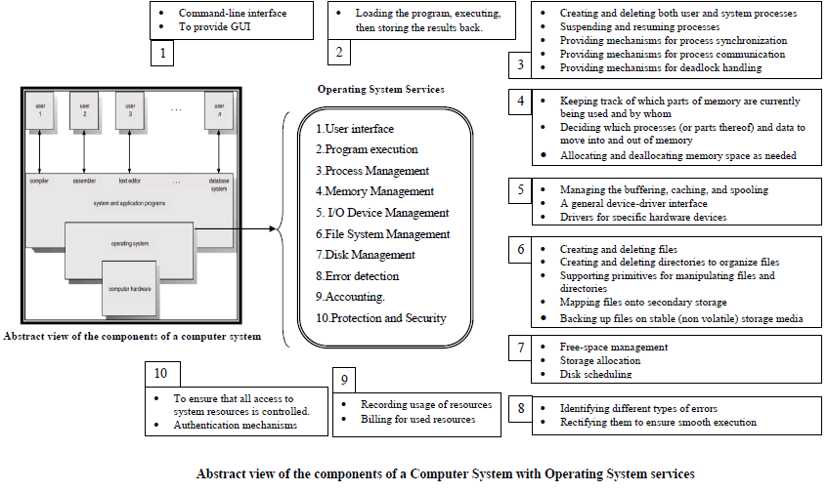

Slide 6
Operating system organization: Process overview
A process is the execution of a program
A process consists of text (machine code), data and stack segments.
Many process can run simultaneously as kernel schedules them for execution
Several processes may be instances of one program
A process reads and writes its data and stack sections, but it cannot read or write the data and stack of other processes
A process communicates with other processes and the rest of the world via system calls
Kernel has a process table that keeps tract of all active processes
Each entry in the process table contains pointers to the text, data, stack and the U Area of a process.
All processes in UNIX system, except the very first process (process 0) which is created by the system boot code, are created by the fork system call
CPU
Memory
code
static data
heap
stack
Process
code
static data
Program

Slide 7
Operating system organization: Process overview
Process Context
The context of a process is its state:
Text, data( variable), register
Process region table, U Area,
User stack and kernel stack
When executing a process, the system is said to be executing in the context of the process.
Mode of Process Execution
The UNIX process runs in two modes:
User mode
Can access its own instructions and data, but not kernel instruction and data
Kernel mode
Can access kernel and user instructions and data
When a process executes a system call, the execution mode of the process changes from user mode to kernel mode
When moving from user to kernel mode, the kernel saves enough information so that it can later return to user mode and continue execution from where it left off.
Mode change is not a context switch, just change in mode.
Context Switch
When the kernel decides that it should execute another process, it does a context switch, so that the system executes in the context of the other process
When doing a context switch, the kernel saves enough information so that it can later switch back to the first process and resume its execution.

Slide 8
Process states and State Transition(Generic)

Slide 9
Process and State Transition(Specific to UNIX)
Process states are:
The process is running in user mode
The process is running in kernel mode
The process is not executing, but it is ready to run as soon as the scheduler chooses it
The process is sleeping
Such as waiting for I/O to complete
Process State Transition
The kernel allows a context switch only when a process moves from the state kernel running to the state asleep
Process running in kernel mode cannot be preempted by other processes.
1
user running
system call
or interrupt
return
2
Interrupt return
kernel running
sleep
schedule process
4
3
asleep
ready to run
wakeup
context switch
permissible

Slide 10
Process and State Transition in more elaborated way..
User Running
1
system call,
interrupt
return
to user
interrupt,
interrupt return
return
Preempted
2
Kernel
Running
7
9
preempt
reschedule
process
Zombie
sleep
4
3
Ready to
Run in Memory
Asleep
in
Memory
wakeup
enough mem
Created
swap
out
8
fork
swap
out
swap
in
not enough mem
(swapping system only)
6
5
wakeup
Sleep, Swapped
Ready to Run, Swapped

Slide 11
Process and State Transition
The complete set of process states
The process is executing in user mode
The process is executing in kernel mode
The process is not executing but is ready to run as soon as the kernel schedules it.
The process is sleeping and resides in main memory.
The process is ready to run, but the swapper (prcoess 0) must swap the process into main memory before the kernel can schedule it to execute.
The process is sleeping, and the swapper has swapped the process to secondary storage to make room for other processes in main memory.
The process is returning from the kernel to user mode, but the kernel preempts it and does a context switch to schedule another process. The distinction between this state and state 3 (" ready-to-run ") will be brought shortly.
The process is newly created and is in a transition state; the process exists, but it is not ready to run, nor is it sleeping. This state is the start state for all processes except process 0.
The process executed the exit system call and is in the zombie state. The process no longer exists, but it leaves a record containing an exit code and some timing statics for its parent process to collect. The zombie state is the final state of a process

Slide 12
Data Structures for Process
Two kernel data structures describe the state of a process: the process table entry and the uarea. The process table contains fields that must always be accessible to the kernel, but the uarea contains fields that need to be accessible only to the running process.
Therefore, the kernel allocates space for the uarea only when creating a process:

Slide 13
Kernel Support for Process:
Kernel Process Table
Kernel Region Table
A Process
Per Process Region Table
Text
File Descriptor Table
Data
Stack
U Area

Slide 14
Process Table:
U area
Kernel has a process table that keeps track of all active processes
Each entry in the process table contains pointers to the text, data, stack and the U Area of a process.
State field: user running, kernel running etc.
Fields that allow the kernel to locate the process and u area. Requires while context switch
Process size : kernel know how much space to allocate for the process.
User ID
Process ID
Event descriptor.
Used when the process is in the "sleep" state.
Scheduling parameters.
Allow the kernel to determine the order in which processes move to the states "kernel running" and "user running”
A signal field.
keeps the signals sent to a process but not yet handled.
Various timers: process execution time, resource utilization etc.
U Area is the extension of process table entry.
Pointer to process table entry
The current directory and current root
User file descriptor table
Limit fields
Restrict process size
Restrict size of the file it can write
The control terminal field:
login terminal associated with the process, if one exists
An array indicates how the process wishes to react to signal

Slide 15
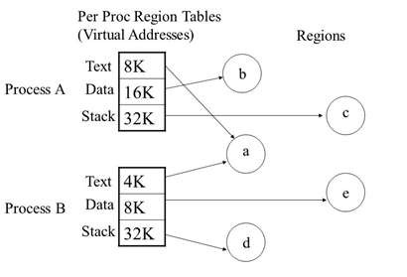
Regions
UNIX system consists of three logical sections: text, data, and stack.
Region :-
is a contiguous area of the virtual address space of a process that can be treated as a distinct object to be shared or protected.
text, data, and stack usually form separate regions of a process. Several processes can share a region.
The kernel contains a region table and allocates an entry from the table for each active region in the system.
Shared regions may have different virtual addresses in each process
Pregion :-
Each process contains a private per process region table, called a pregion.
Pregion entries may exist in the process table, the u area, or in a separately allocated area of memory, dependent on the implementation.
Each pregion entry points to a region table entry and contains the starting virtual address of the region in the process.
The pregion entry also contains a permission field that indicates the type of access allowed the process: read-only, read-write, or read-execute.
Eg. Of Processes & Regions
The concept of the region is independent of the memory management policies implemented by the operating system

Slide 16
Region Table
Region table entries describes the attributes of the region, such as whether it contains text or data, whether it is shared or private
Per Process Region Table (Pregion)
The traditional kernel allocates several process regions, called pregions, for each process. The collection of pregions of a process form the per process region table.
The pregion data structure is used to record the following information:
The region types (e.g. text, data, stack, etc.)
Each pregion entry points to the kernel region table
Starting virtual (absolute) address of the region
Permission field: read-only, read-write, read-execute
The extra level from the per process region table to kernel region table allows independent processes to share regions.
Kernel Region table
Kernel region table contains the pointer to the page table which keeps the physical memory address

Slide 17
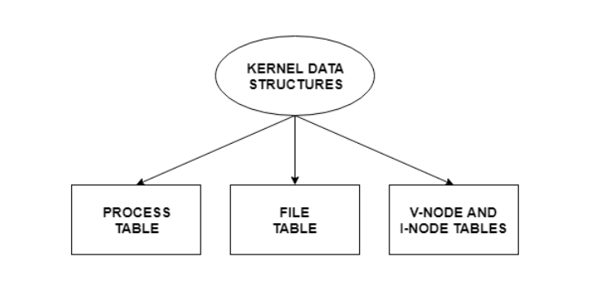
Kernel Data Structures
The kernel data structures are very important as they store data about the current state of the system. For example, if a new process is created in the system, a kernel data structure is created that contains the details about the process.
Most of the kernel data structures are only accessible by the kernel and its subsystems. They may contain data as well as pointers to other data structures.
Kernel Components
The kernel stores and organizes a lot of information. So it has data about which processes are running in the system, their memory requirements, files in use etc. To handle all this, three important structures are used. These are process table, file table and v node/ i node information.
Process Table
The process table stores information about all the processes running in the system. These include the storage information, execution status, file information etc. When a process forks a child, its entry in the process table is duplicated including the file information and file pointers. So the parent and the child process share a file.
File Table
The file table contains entries about all the files in the system. If two or more processes use the same file, then they contain the same file information and the file descriptor number. Each file table entry contains information about the file such as file status (file read or file write), file offset etc. The file offset specifies the position for next read or write into the file. The file table also contains v-node and i-node pointers which point to the virtual node and index node respectively. These nodes contain information on how to read a file.
V-Node and I-Node Tables
Both the v-node and i-node are references to the storage system of the file and the storage mechanisms. They connect the hardware to the software. The v-node is an abstract concept that defines the method to access file data without worrying about the actual structure of the system. The i-node specifies file access information like file storage device, read/write procedures etc.

Slide 18
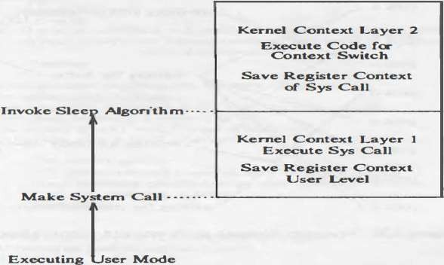
Sleep
The algorithms for sleep, which changes the process state from "kernel running" to "asleep in memory," and wakeup, which changes the process state from "asleep" to "ready to run" in memory or swapped.
When a process goes to sleep, it typically does so during execution of a system call: The process enters the kernel (context layer I) when it executes an operating system trap and goes to sleep awaiting a resource. When the process goes to sleep, it does a context switch, pushing its current context layer and executing in kernel context layer 2 (Figure).
Processes also go to sleep when they incur page faults as a result of accessing virtual addresses that are not physically loaded; they sleep while the kernel reads in the contents of the pages.
Figure 8 : Typical Context Layers of Sleeping Process

Slide 19
Sleep…Continued…
Sleep Events and Addresses:
Processes are said to sleep on an event, meaning that they are in the sleep state until the event occurs, at which time they wake up and enter a "ready-to-run" state (in memory or swapped out). Although the system uses the abstraction of sleeping on an event, the implementation maps the set of events into a set of (kernel) virtual addresses.
The addresses that represent the events are coded into the kernel, and their only significance is that the kernel expects an event to map into a articular address.
The abstraction of the event does not distinguish how many processes are awaiting the event, nor does the implementation. As a result, two anomalies arise. First, when an event occurs and a wakeup call is issued for processes that are sleeping on the event, they all wake up and move from a sleep state to a ready-to-run state.

Slide 20
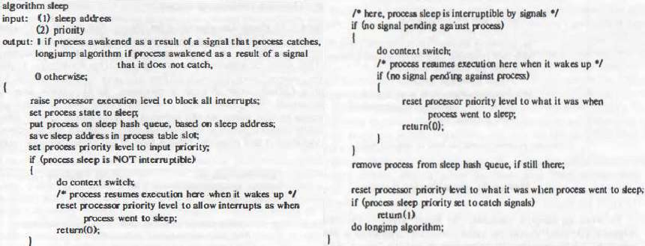
Sleep

Slide 22
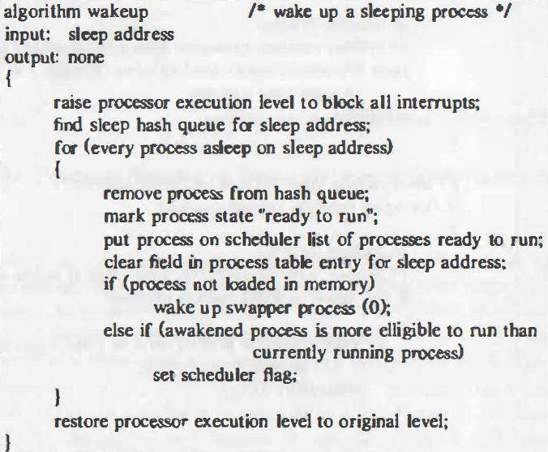
Wakeup Algorithm
To wake up sleeping processes, the kernel executes the wakeup algorithm, either during the usual system call algorithms or when handling an interrupt.
For instance, the algorithm iput releases a locked inode and awakens all processes waiting for the lock to become free.
Similarly, the disk interrupt handler awakens a process waiting for I/O completion. The kernel raises the processor execution level in wakeup to block out interrupts.

Slide 23
To distinguish the types of sleep states, the kernel sets the scheduling priority of the sleeping process when it enters the sleep state, based on the sleep priority parameter. That is, it invokes the sleep algorithm with a priority value, based on its knowledge that the sleep event is sure to occur or not.
If the priority is above a threshold value, the process will not wake up prematurely on receipt of a signal but will sleep until the event it is waiting for happens. But if the priority value is below the threshold value, the process will awaken immediately on receipt of the signal.

Slide 24
Thank You

